Slide 1
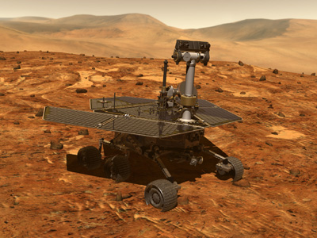
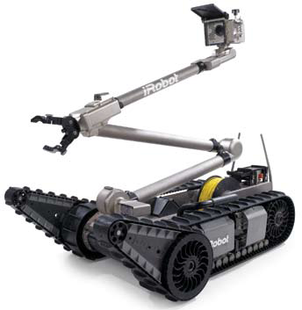
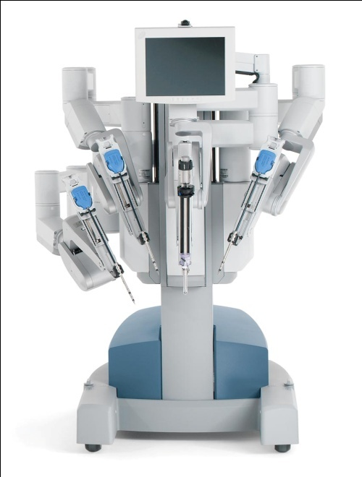
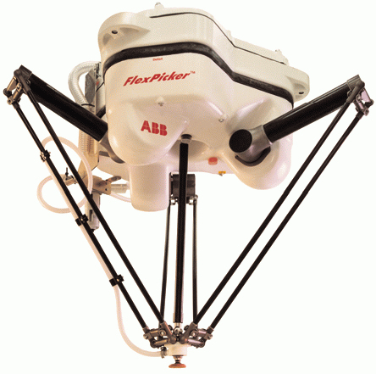
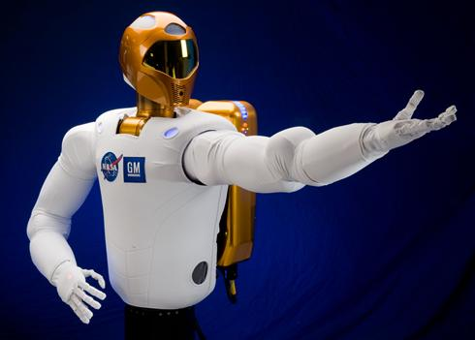
Introduction to Robotics
WIA1004/WAES 1102

Slide 2
Topics
Why are robots important?
Types of robots
Future growth areas
Technologies used in robotics
Technical disciplines needed in robotics
Sensing and Sensors

Slide 3
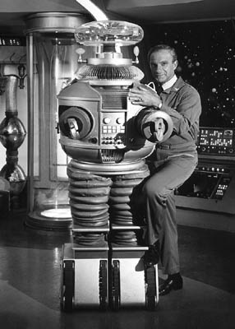
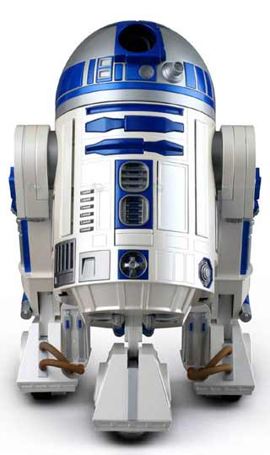
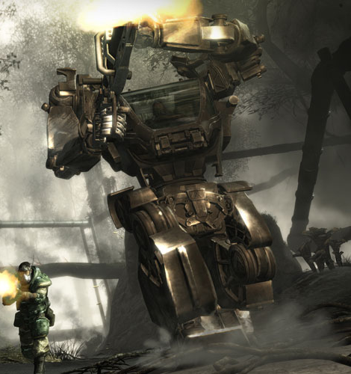
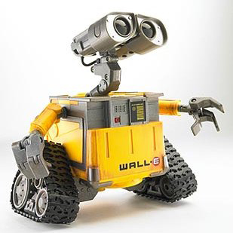
What do you think of when you hear the word “robot”?
Notes:
automotive
Dangerous, hazardous areas
Bomb recovery
Underwater
Rescue
Home

Slide 4

Why Robotics?
Areas that robots are used:
Industrial robots
Military, government and space robots
Service robots for home, healthcare, laboratory
Why are robots used?
Dangerous tasks or in hazardous environments
Repetitive tasks
High precision tasks or those requiring high quality
Labor savings
Control technologies:
Autonomous (self-controlled), tele-operated (remote control)

Slide 5
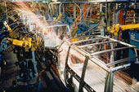
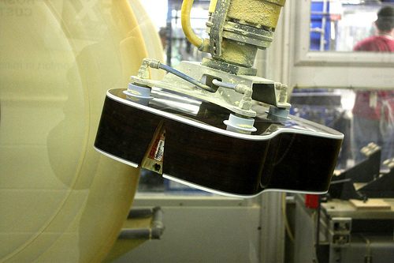
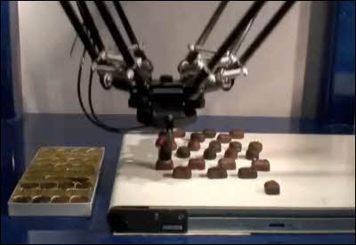
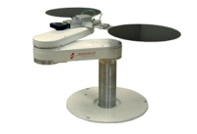
Industrial Robots
Uses for robots in manufacturing:
Welding
Painting
Cutting
Dispensing
Assembly
Polishing/Finishing
Material Handling
Packaging, Palletizing
Machine loading

Slide 6
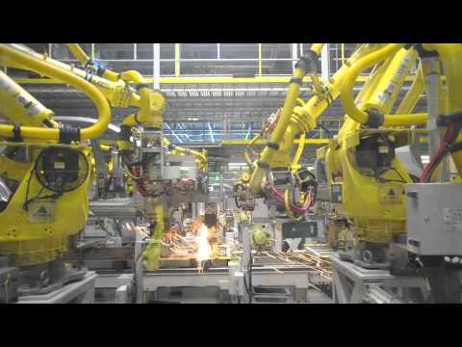
Industrial Robots - Automotive
Notes:
http://www.youtube.com/watch?v=sjAZGUcjrP8
Car Factory - Kia Sportage factory production line

Slide 7
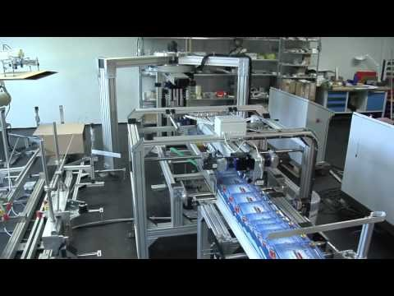
Industrial Robots - Packaging
Notes:
http://www.youtube.com/watch?v=tMVoxMhmxEM
Mitsubishi Electric - Industrial robot: Innovative Packaging system

Slide 8
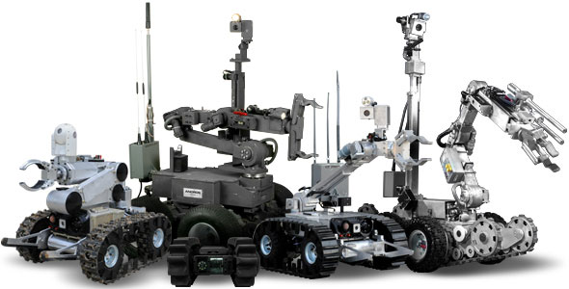
Military/Government Robots
iRobot PackBot
Remotec Andros

Slide 9
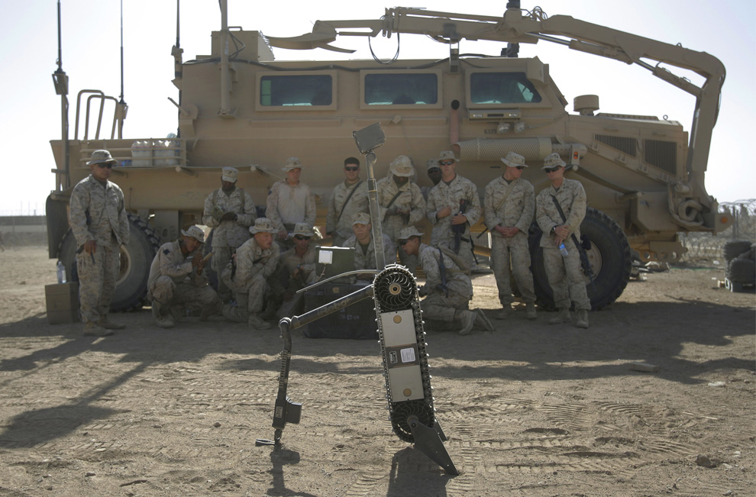
Military/Government Robots
Soldiers in Afghanistan being trained how to defuse a landmine using a PackBot.

Slide 10
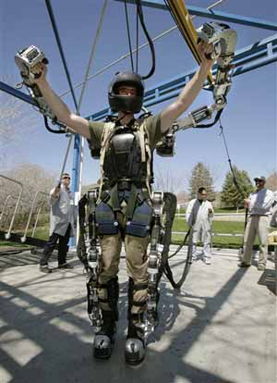
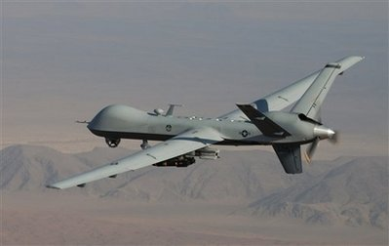
Military Robots
Aerial drones (UAV)
Military suit

Slide 11
Space Robots
Mars Rovers – Spirit and Opportunity
Autonomous navigation features with human remote control and oversight

Slide 12
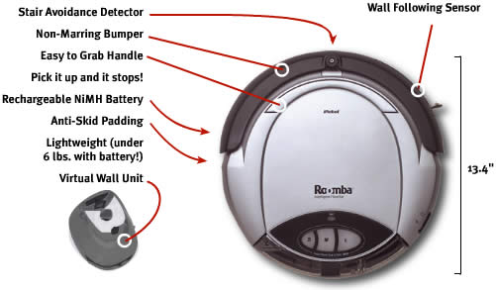
Service Robots
Many uses…
Cleaning & Housekeeping
Rehabilitation
Inspection
Agriculture & Harvesting
Lawn Mowers
Surveillance
Mining Applications
Construction
Automatic Refilling
Fire Fighters
Search & Rescue
iRobot Roomba vacuum cleaner robot

Slide 13
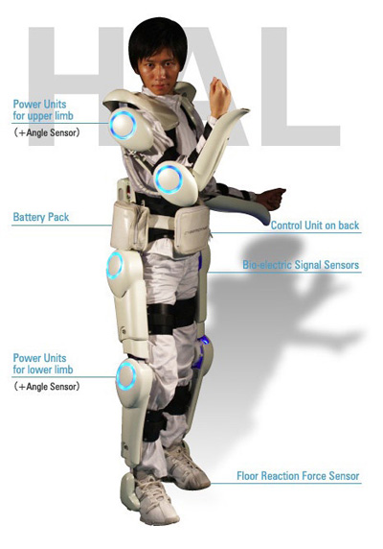
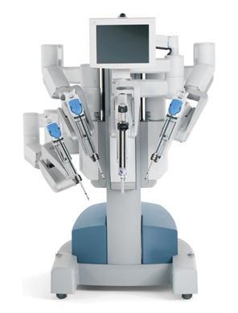
Medical/Healthcare Applications
DaVinci surgical robot by Intuitive Surgical.
St. Elizabeth Hospital is one of the local hospitals using this robot. You can see this robot in person during an open house (http://www.youtube.com/watch?v=EiVY-htgRUY)
Japanese health care assistant suit (HAL - Hybrid Assistive Limb)
Also… Mind-controlled wheelchair using NI LabVIEW

Slide 14
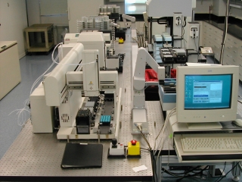
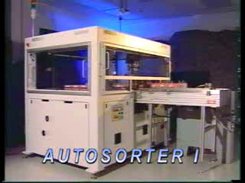
Laboratory Applications
Drug discovery
Test tube sorting

Slide 15
Technologies Used in Robotics
Drivetrain – servomotors, gear reducers
Hydraulics (oil), pneumatics (air)
Electrical controls – motor drives, computers
Lightweight materials – aluminum, carbon fiber, titanium
Sensors
Photoeyes
Encoders/position measurement sensors
Proximity switches
Laser scanners
Vision systems
Navigation systems/GPS

Slide 16
Disciplines Used in Robotics
Robotics merges many technical disciplines:
Bio-Medical Engineering
Ethics and Legal Issues
Mechanical Engineering
Electrical Engineering
Computer Science
Latest advancement:
Artificial Intelligence
Mechatronics
Intelligent
Agents

Slide 17
Sensing and Sensors

Slide 18
Human Sensing
Sense:
Vision
Audition
Gustation
Olfaction
Tactile
Thermoception
Nociception
Equilibrioception
Proprioception
Sensed what?
EM waves
Pressure waves
Chemicals - flavor
Chemicals - odor
Contact pressure
Heat
Pain
Sense of balance
Body awareness
Sensor?
Eyes
Ears
Tongue
Nose
Skin
Skin
Skin, organs, joints
Ears
Muscles, joints

Slide 19
Robot Sensors
Sense:
Vision
Audition
Gustation
Olfaction
Tactitions
Thermoception
Sensor:
Camera
Microphone
Chemical sensors
Chemical sensors
Contact sensors
Thermocouple

Slide 20
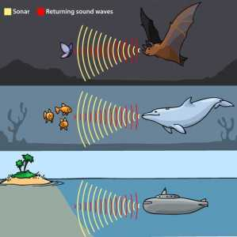
Robot Sensors
Sense:
Equilibrioception
Proprioception
Magnetoception
Electroception
Echolocation
Sensor:
Accelerometer
Encoders
Magnetometer
Voltage sensor
Sonar

Slide 21
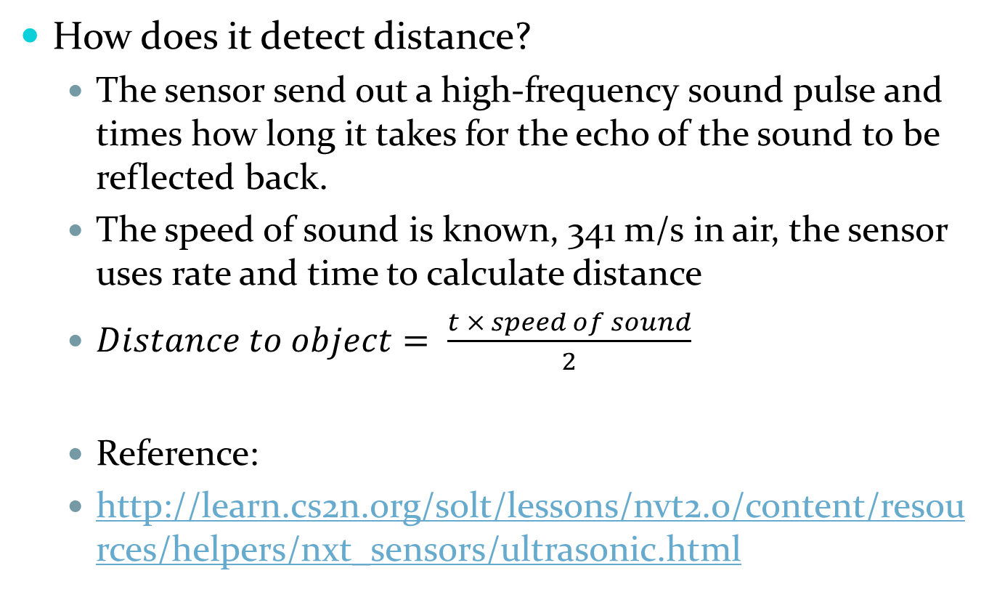
Sonar Sensor
How does it detect distance?
The sensor send out a high-frequency sound pulse and times how long it takes for the echo of the sound to be reflected back.
The speed of sound is known, 341 m/s in air, the sensor uses rate and time to calculate distance
$Distance to object= \frac{t × speed of sound}{2}$
Reference:
http://learn.cs2n.org/solt/lessons/nvt2.0/content/resources/helpers/nxt_sensors/ultrasonic.html

Slide 22
Sonar Sensor
Factors that might limit the accuracy of sonar reading:
Object too far away
Flat object is not facing sensor
Object is too small
Object is too soft

Slide 23
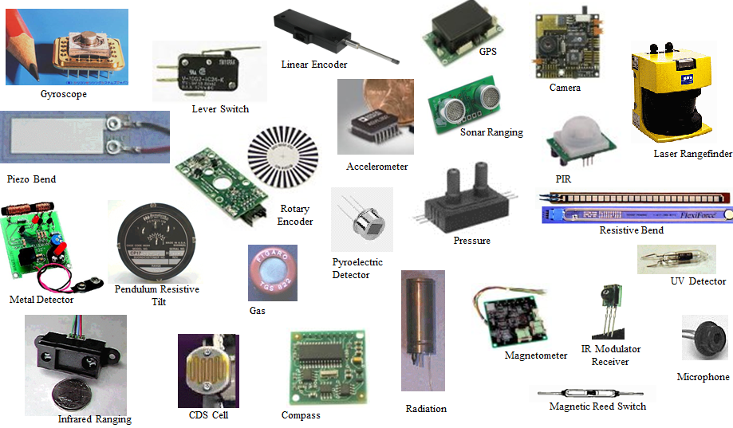
Sample of robot sensors

Slide 24
Robot Sensory Architecture

Slide 25
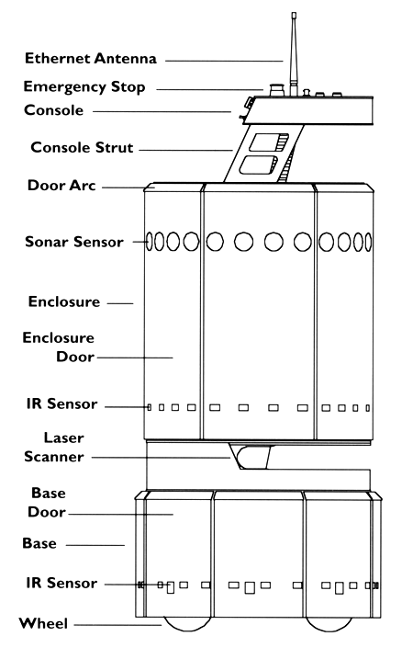
B21 robot’s real world interface

Slide 26
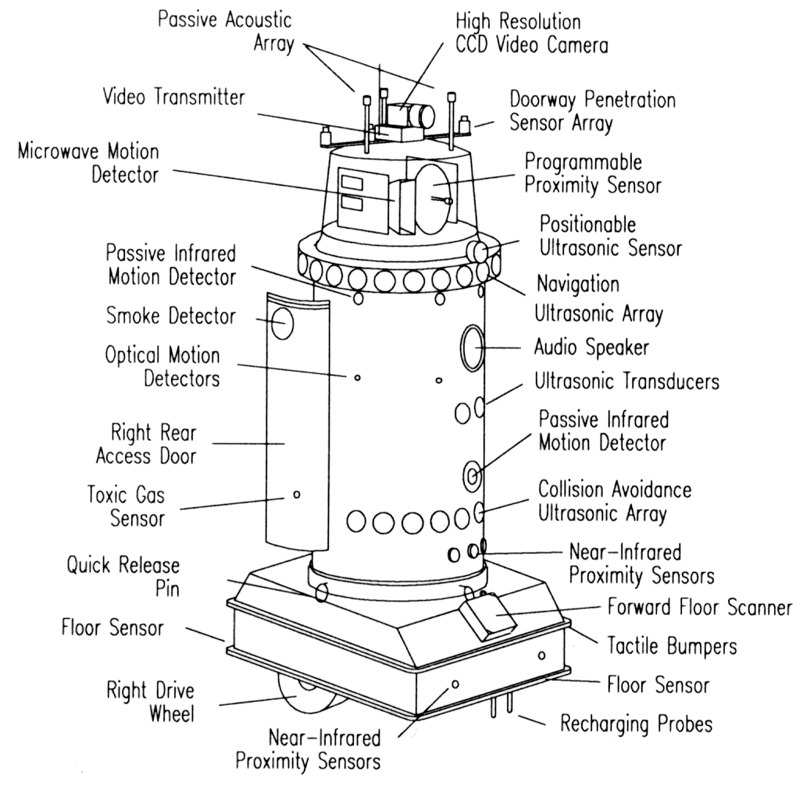
Robart II, by H.R. Everett
Notes:
Robart II, H.R. Everett

Slide 27
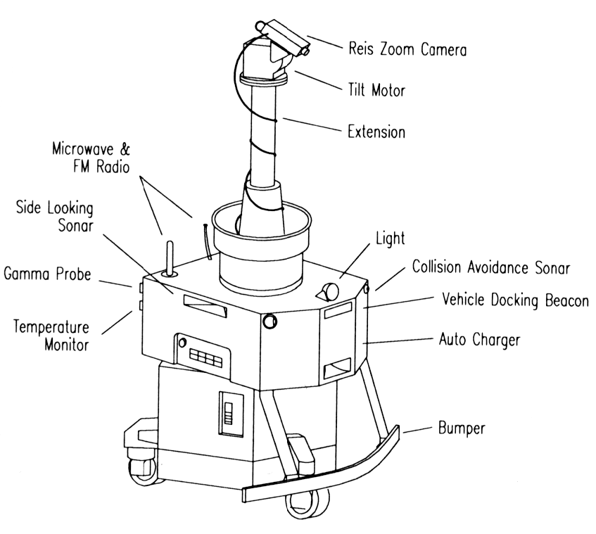
Notes:
Savannah (River site nuclear surveillance robot)

Slide 28
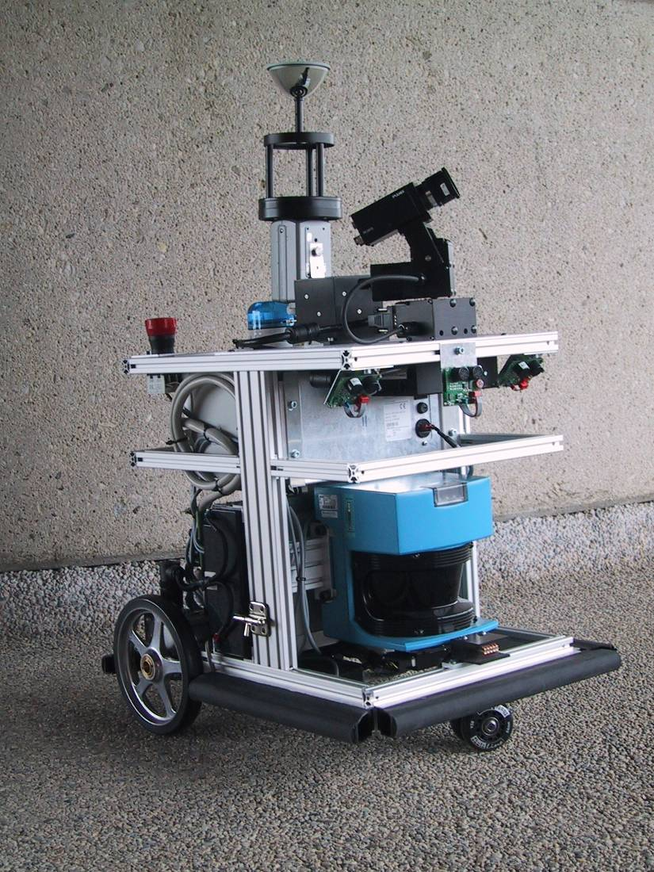
BibaBot, BlueBotics SA, Switzerland
Omnidirectional Camera
Pan-Tilt Camera
IMU Inertial Measurement Unit
Sonar Sensors
Emergency Stop Button
Laser Range Scanner
Wheel Encoders
Bumper

Slide 29
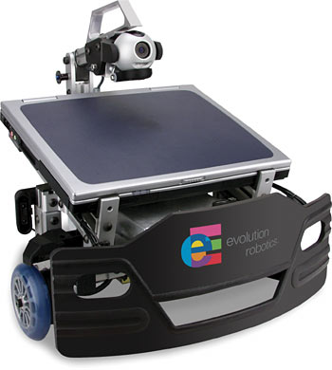
Evolution Robotics’ Scorpion
Logitech QuickCam Pro 3000
640 X 480 video; 1.3 MP still mode
Built-in microphone for sound/voice recognition applications
IR Sensors
4 ledge detection sensors
3 up-facing sensors
13 horizontal facing sensors
Bump Sensor

Slide 30
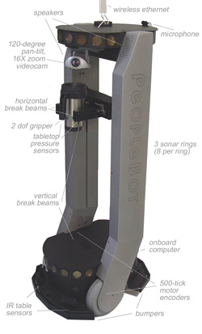
Activmedia Robotics’ PeopleBot

Slide 31
Classification of Sensors
Proprioceptive (internal) sensors
Measure values internally to the system (robot)
E.g. motor speed, wheel load, heading of the robot, battery status
Exteroceptive (external) sensors
Information from the robots environment
Distances to objects, intensity of the ambient light, unique features

Slide 32
Sensor Performance Measurement in real world environment is error prone
Basic sensor response ratings
Dynamic range: Ratio between lower and upper limits, usually in decibels
Range: Difference between min and max
Resolution: Minimum difference between two values
Linearity: Variation of output signal as function of the input signal
Bandwidth or frequency: The speed with which a sensor can provide a stream of readings

Slide 33
Sensor Performance
Mobile robots have to perceive, analyze and interpret the state of their surroundings
Measurements in real world environments are dynamically changing and error prone
Examples:
Changing illuminations
Specular reflections
Light or sound absorbing surfaces
Non adaptive to environment changes (climate (heat/damp), surface, texture, etc)

Slide 34
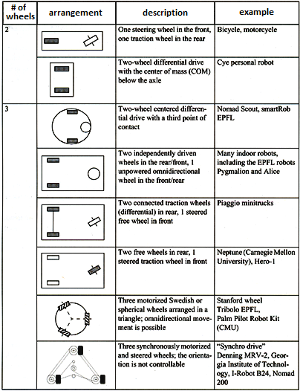
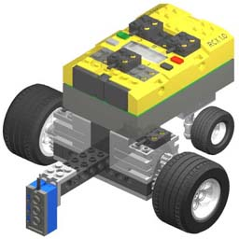
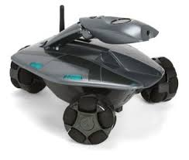
Wheel/Motor Encoders

Slide 35
Heading Sensors
Heading sensors can be proprioceptive/internal (gyroscope, inclinometer) or exteroceptive/external (compass)
Used to determine the robots orientation and inclination (slope/gradient descent)
Allow, together with appropriate velocity information, to integrate movement to a position estimate
This procedure is called dead reckoning (ship navigation)

Slide 36
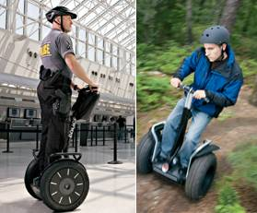
Gyroscope
Heading sensors, that keep the orientation to a fixed frame
Absolute measure for the heading of a mobile system
Gyroscopes are used in aeroplanes, Segways and the space shuttle and affect how yo-yos and bicycles work!
Two categories of gyroscopes
Mechanical gyroscopes
Optical gyroscopes
(not covered in this lecture)

Slide 37
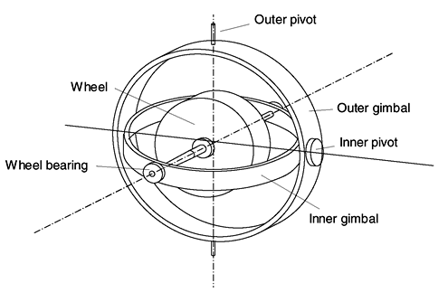
Gyroscope
Concept: inertial properties of a fast spinning rotor
Gyroscopic precession
Angular momentum associated with a spinning wheel keeps the axis of the gyroscope inertial-ly stable
Reactive torque t (tracking stability) is proportional to the spinning speed w, the precession speed W and the wheels inertia I

Slide 38
Compass
The compass has been around since at least 2000 B.C.
The Chinese suspended a piece of natural magnetite from a silk thread and used it to guide a chariot over land
Magnetic field on earth
Absolute measure for orientation

Slide 39
Compass
There are a large variety of ways to measure the earth’s magnetic field
Mechanical magnetic compass
Direct measure of the magnetic field (Hall-effect, magneto-resistive sensors)
Major drawback
Weakness of the earth’s magnetic field
Easily disturbed by magnetic objects or other sources
Not feasible for indoor environments

Slide 40
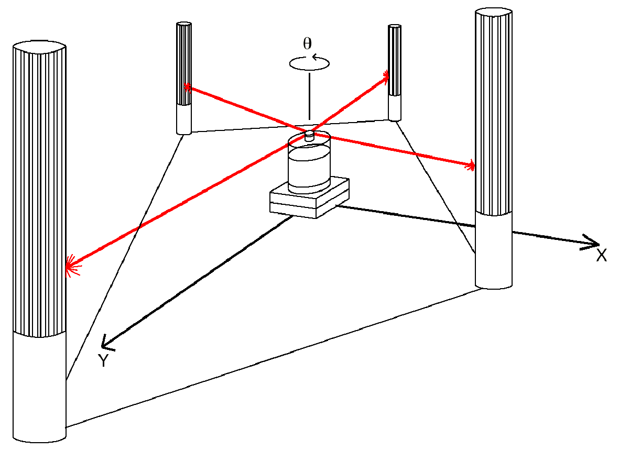
Beacons (ground based)
Elegant way to solve the localization problem in mobile robotics
Beacons are signaling guiding devices with a precisely known position
Beacon base navigation has been used since humans started to travel
Natural beacons (landmarks) like stars, mountains or the sun
Artificial beacons like lighthouses

Slide 41
Beacons (ground based)
The recently introduced Global Positioning System (GPS) has revolutionized modern navigation technology
Already one of the key sensors for outdoor mobile robotics
For indoor robots GPS is not applicable
Major drawback with the use of beacons in indoor:
Beacons require changes in the environment -> costly
Limit flexibility and adaptability to changing environments

Slide 42
Range Sensors
The traveled distance of a sound or electromagnetic wave is given by
d = c . t
Where
d = distance traveled (usually round-trip)
c = speed of wave propagation
t = time of flight.

Slide 43
Range Sensors
It is important to point out:
Propagation speed of sound: ~0.3 m/ms
Propagation speed of of electromagnetic signals: ~0.3 m/ns
3 meters
Takes 10ms for an ultrasonic system
Only 10ns for a laser range sensor
Measuring time of flight with electromagnetic signals is not an easy task
Laser range sensors are expensive and delicate

Slide 44
Range Sensors
The quality of time of flight range sensors mainly depends on:
Uncertainties about the exact time of arrival of the reflected signal
Inaccuracies in the time of fight measure (laser range sensors)
Opening angle of transmitted beam (ultrasonic range sensors)
Interaction with the target (surface, specular reflections)
Variation of propagation speed
Speed of mobile robot and target (if not at rest)

Slide 45
Sensors Summary
Robots use sensors to sense what is going on in the world around them
Sensors can be broadly categorised as proprioceptive or exteroceptive and active or passive
Sensor error can be a serious issue that we need to take care of
There are many kinds of sensors that offer different levels of performance, error, price, etc

